Slide 1
Timecard
Daniel Tager

Slide 2
Main Elements
The Login Screen
The Registration Screen
The Time Tracking Screen
The Backend Data Management

Slide 3

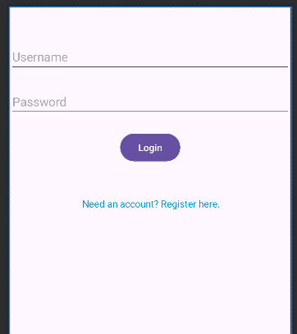
Login Screen
Username
Password
Button
Register link

Slide 4
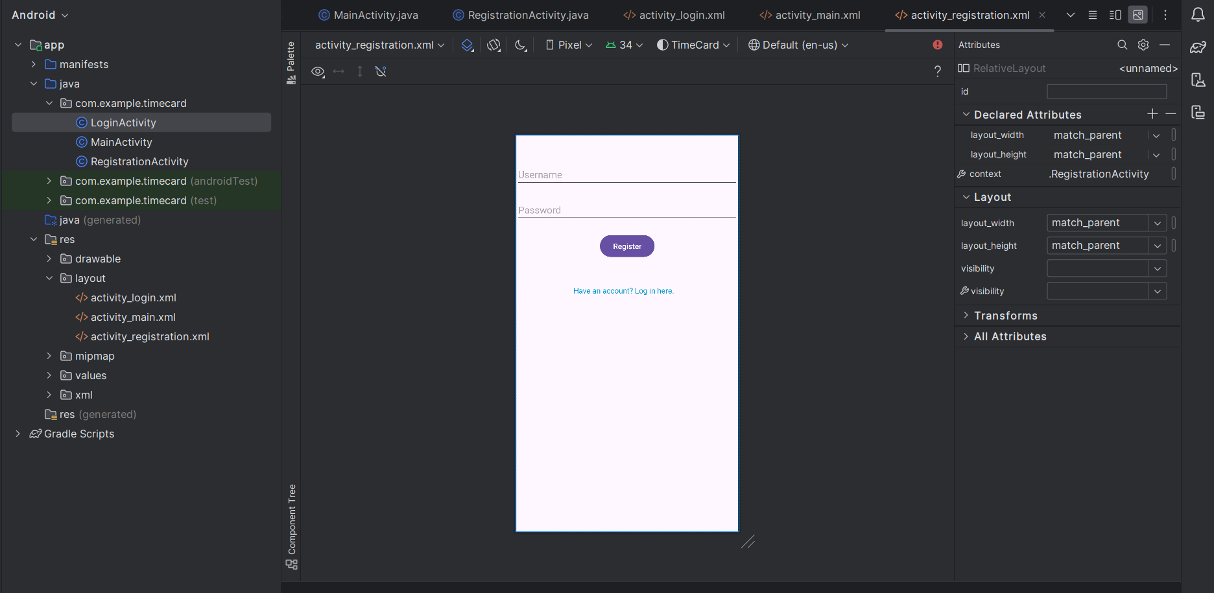
Login xml

Slide 5
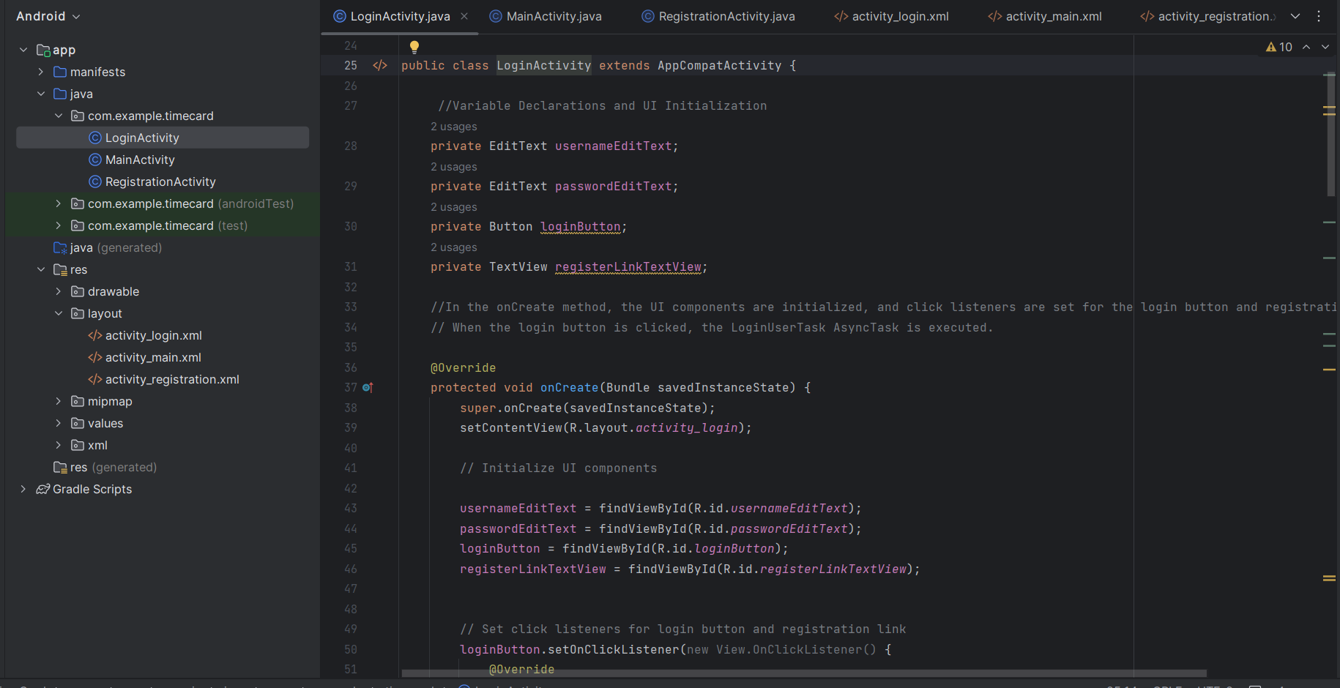
Login Java

Slide 6
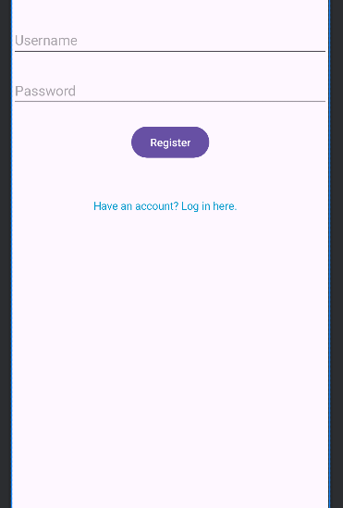
Registration
Screen
Username
Password
Button
Login Link

Slide 7
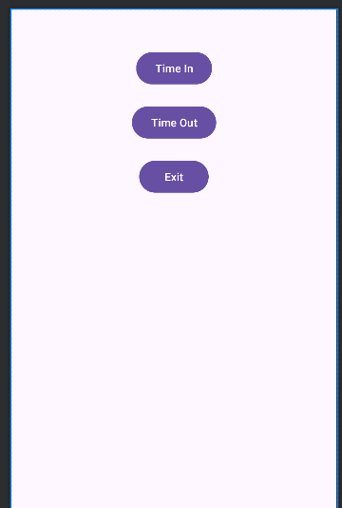
Time Tracking Screen
Time In Button
Time Out Button
Exit Button
Text View

Slide 8
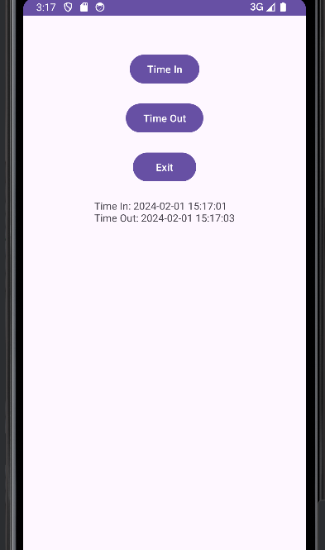
Text View
Time in or out recorded that day.
Text view is empty at the start of a new day.

Slide 9
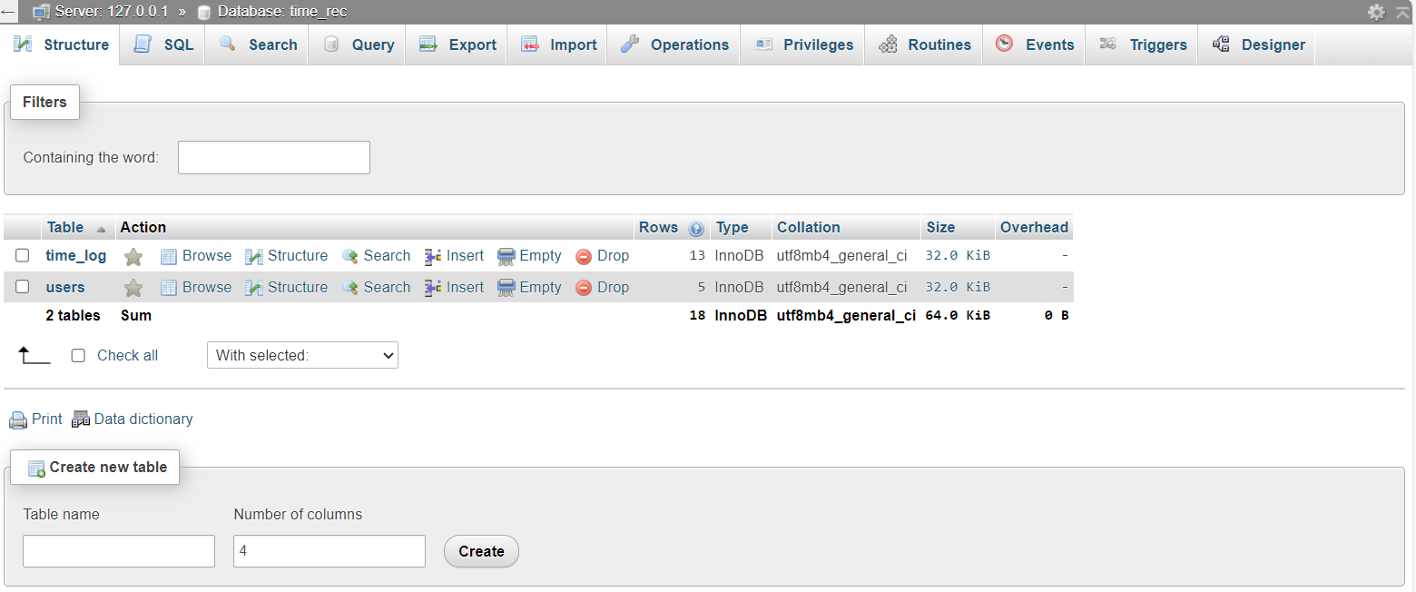
Data Management

Slide 10
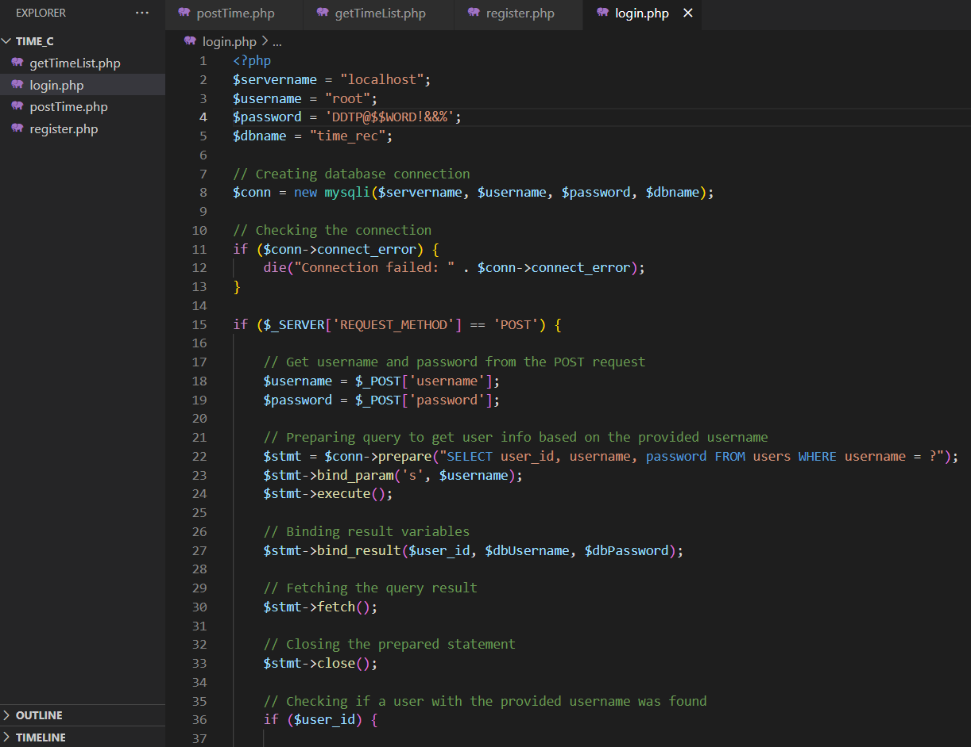
PHP Code
Login PHP
Register PHP
Post Time PHP
Get Time PHP

Slide 11
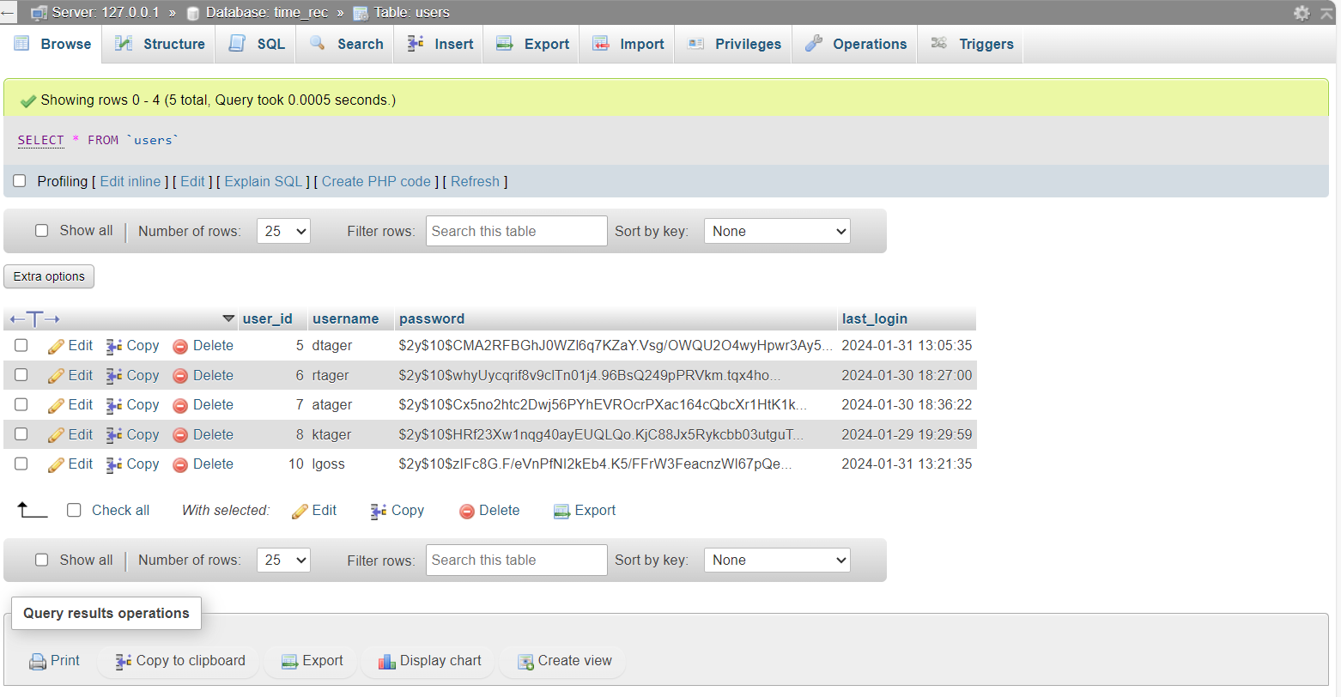
Users Table

Slide 12
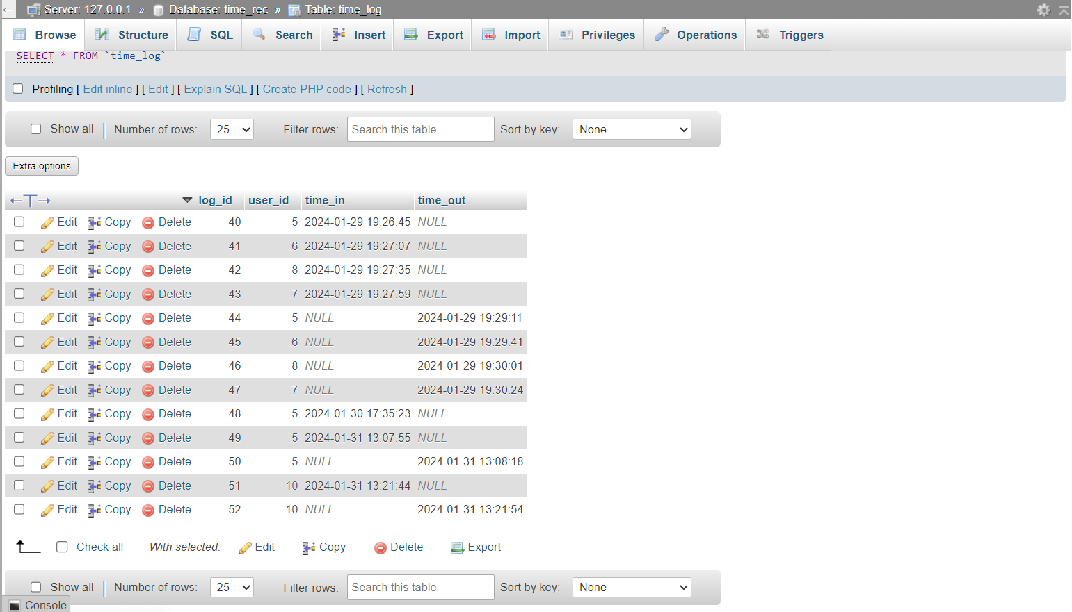
Time Log Table

Slide 13

Time Records

Slide 14

Thank You

